Slide 1
Offensive Security
seamus and seamus and rj (oh my!)

Slide 2
What is Offensive Security?
Subset of the security field focusing on assessing the security of machines/networks by attempting to attack them
Proactive instead of reactive

Slide 3
Why do we do it?
Approach your network from the mindset of an attacker
Look at the difference between how your network is supposed to be, and how it is
It’s fun

Slide 4
Penetration Testing vs Red Teams
Penetration testing is a time-bound assessment with the goal of finding as many vulnerabilities and misconfigurations as possible, along with the potential impact of those findings (eg. Domain Admin)
Red team assessments are not scoped to find as many vulnerabilities as possible, but to test the detection and response capabilities of the blue team
Can emulate specific threat actors in the organization’s threat model
Penetration tests are usually from outside consulting organizations, and red teams are usually internal to a company.

Slide 5
Penetration testing Lifecycle
Broadly defined phases of an assessment
A key part of penetration testing is reporting

Slide 6
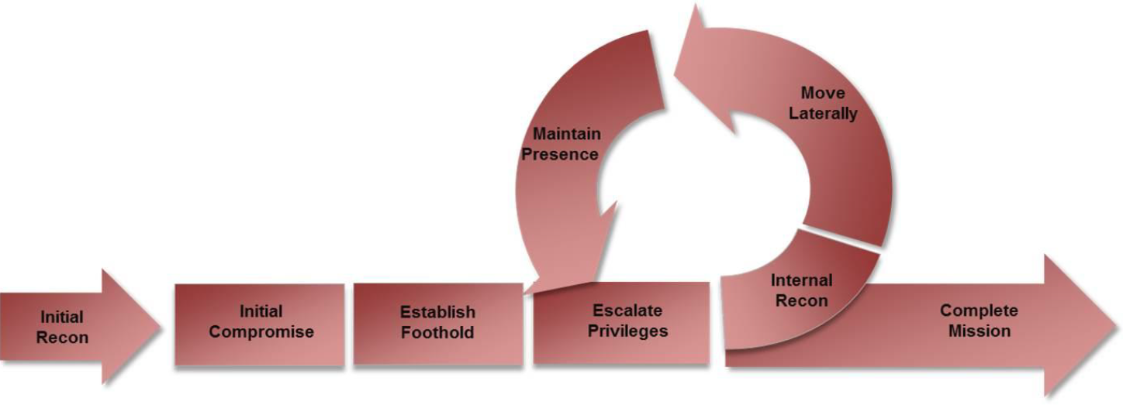
Attacker Lifecycle

Slide 7
Todo: add other slides from last year I hope seamus has them but probably not

Slide 8
But what if you can’t just run someone else’s script?
Metasploit is great if the system is vulnerable to something metasploit has a payload for
But it doesn’t have a payload for everything
Think about CDE with the lol.co program
There’s no Metasploit payload for that
But the red team still could exploit it

Slide 9
Welcome to Pwn
Many different types of vulnerabilities in binaries:
Stack buffer overflows
Heap buffer overflows
Format string bugs
Unlink Corruption
Use After Free
Command Injection
And many many more
If you’re interested in these come to our Spring meetings!

Slide 10
Now we have a demo
Because seamus was too lazy to make slides

